Slide 1
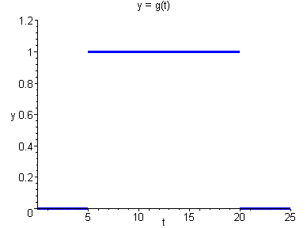
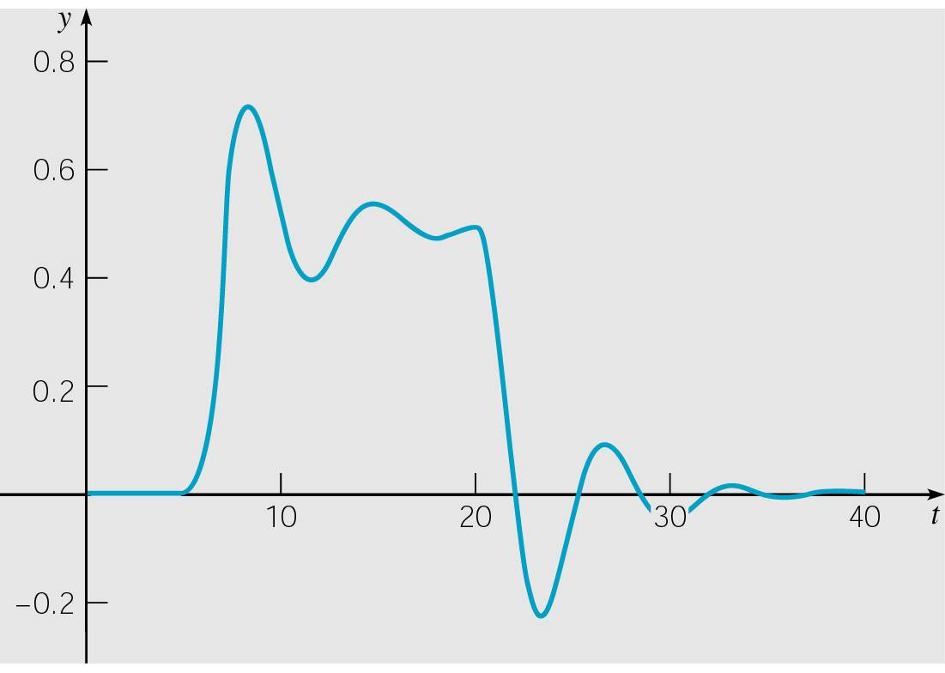
Ch 6.4: Differential Equations with Discontinuous Forcing Functions
In this section, we focus on examples of nonhomogeneous initial value problems in which the forcing function is discontinuous.

Slide 2
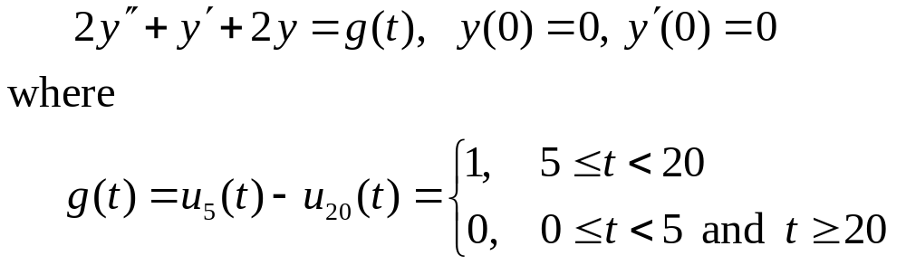
Example 1: Initial Value Problem (1 of 12)
Find the solution to the initial value problem
Such an initial value problem might model the response of a damped oscillator subject to g(t), or current in a circuit for a unit voltage pulse.

Slide 3
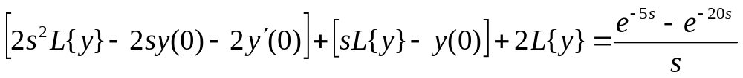

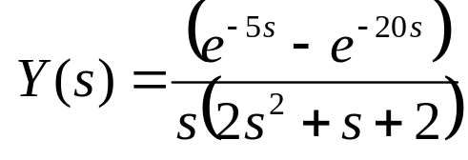
Example 1: Laplace Transform (2 of 12)
Assume the conditions of Corollary 6.2.2 are met. Then
or
Letting Y(s) = L{y},
Substituting in the initial conditions, we obtain
Thus

Slide 4
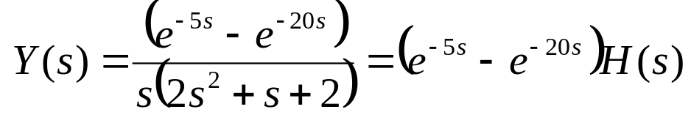
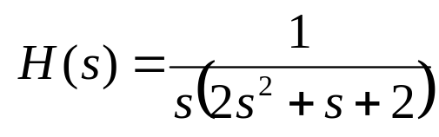

Example 1: Factoring Y(s) (3 of 12)
We have
where
If we let h(t) = L⁻¹{H(s)}, then
by Theorem 6.3.1.
If we know how to find the inverse of H(s), we can apply thm 6.3.1, and split the exponential term as this

Slide 5
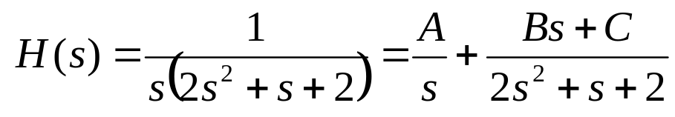
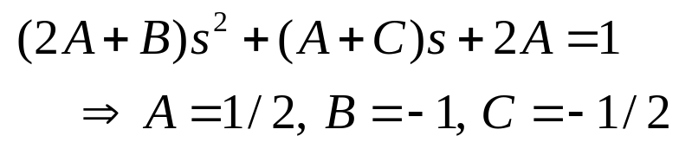
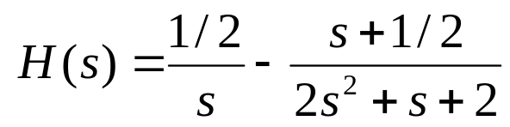
Example 1: Partial Fractions (4 of 12)
Thus we examine H(s), as follows.
This partial fraction expansion yields the equations
Thus

Slide 6
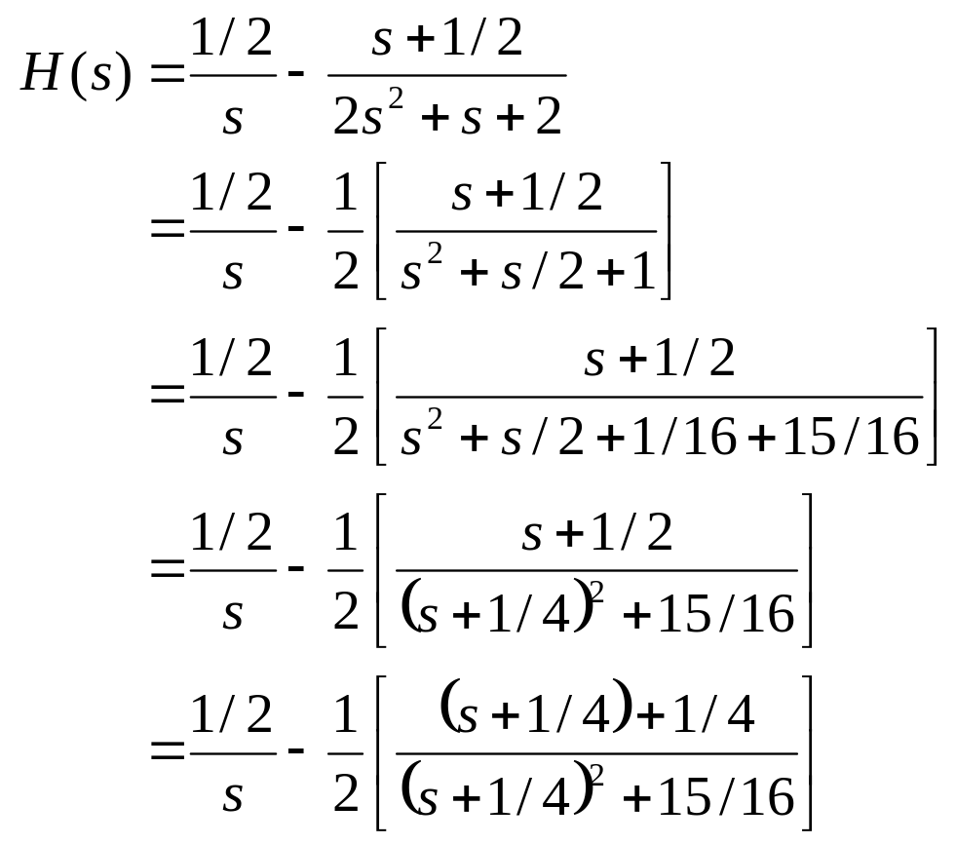
Example 1: Completing the Square (5 of 12)
Completing the square,

Slide 7
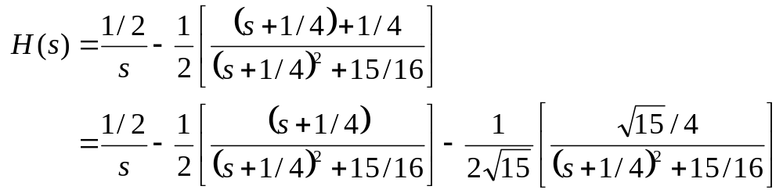
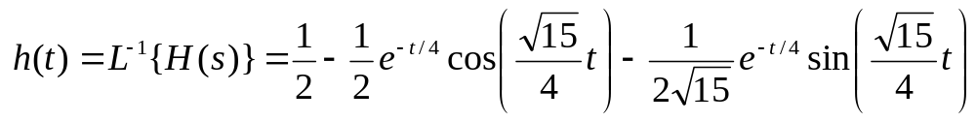

Example 1: Solution (6 of 12)
Thus
and hence
For h(t) as given above, and recalling our previous results, the solution to the initial value problem is then

Slide 8
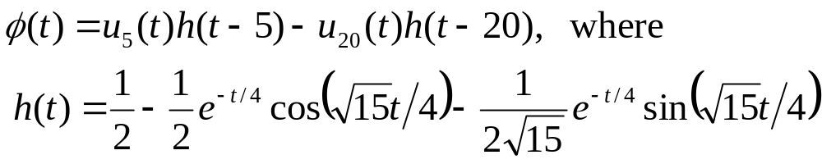
Example 1: Solution Graph (7 of 12)
Thus the solution to the initial value problem is
The graph of this solution is given below.

Slide 9
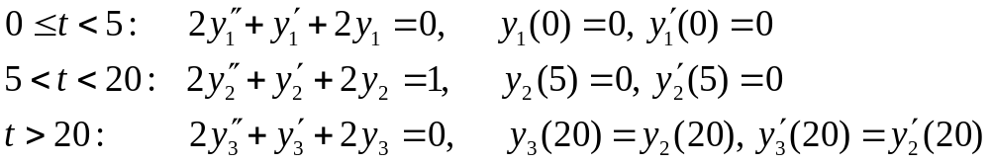
Example 1: Composite IVPs (8 of 12)
The solution to original IVP can be viewed as a composite of three separate solutions to three separate IVPs:

Slide 10
Example 1: First IVP (9 of 12)
Consider the first initial value problem
From a physical point of view, the system is initially at rest, and since there is no external forcing, it remains at rest.
Thus the solution over [0, 5) is y₁ = 0, and this can be verified analytically as well. See graphs below.

Slide 11
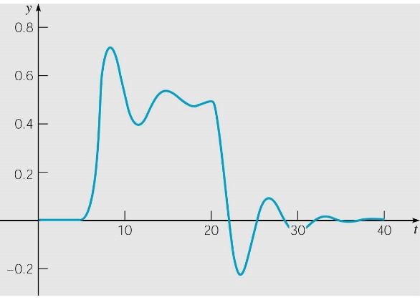
Example 1: Second IVP (10 of 12)
Consider the second initial value problem
Using methods of Chapter 3, the solution has the form
Physically, the system responds with the sum of a constant (the response to the constant forcing function) and a damped oscillation, over the time interval (5, 20). See graphs below.

Slide 12
Example 1: Third IVP (11 of 12)
Consider the third initial value problem
Using methods of Chapter 3, the solution has the form
Physically, since there is no external forcing, the response is a damped oscillation about y = 0, for t > 20. See graphs below.

Slide 13

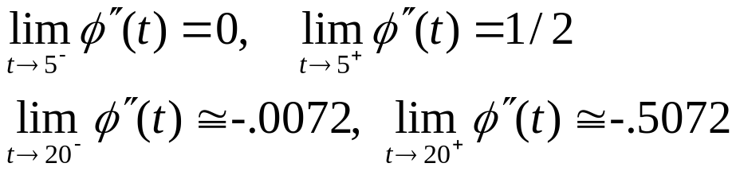
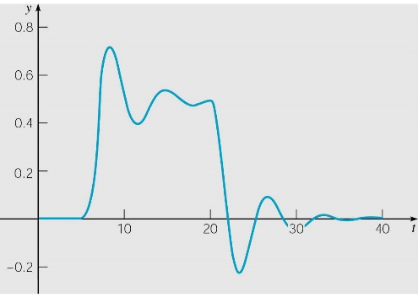
Example 1: Solution Smoothness (12 of 12)
Our solution is
It can be shown that φ and φ' are continuous at t = 5 and t = 20, and φ'' has a jump of 1/2 at t = 5 and a jump of –1/2 at t = 20:
Thus jump in forcing term g(t) at these points is balanced by a corresponding jump in highest order term 2y'' in ODE.

Slide 14

Smoothness of Solution in General
Consider a general second order linear equation
where p and q are continuous on some interval (a, b) but g is only piecewise continuous there.
If y = ψ(t) is a solution, then ψ and ψ ' are continuous on (a, b) but ψ '' has jump discontinuities at the same points as g.
Similarly for higher order equations, where the highest derivative of the solution has jump discontinuities at the same points as the forcing function, but the solution itself and its lower derivatives are continuous over (a, b).

Slide 15
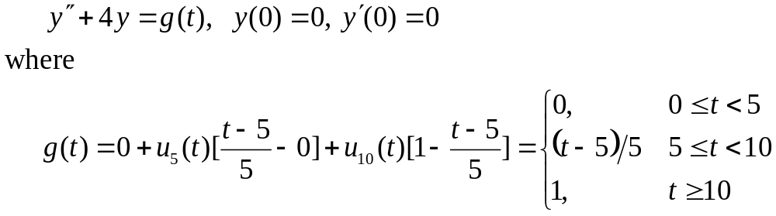
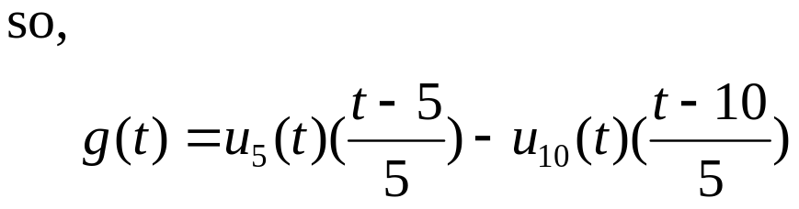
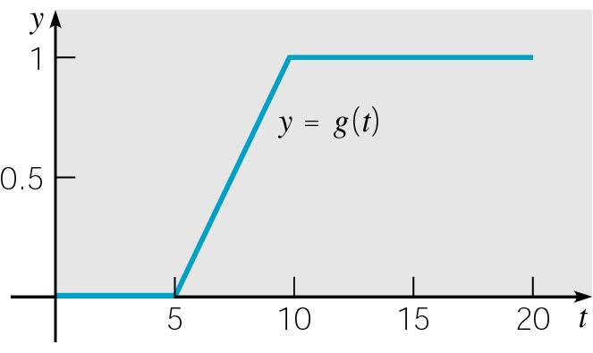
Example 2: Initial Value Problem (1 of 12)
Find the solution to the initial value problem
The graph of forcing function
g(t) is given on right, and is
known as ramp loading.

Slide 16
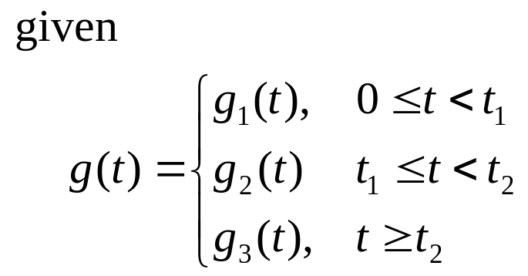
Example 2: Initial Value Problem (1’ of 12)
The formula on the previous slide may be generalized to:
Then,

Slide 17
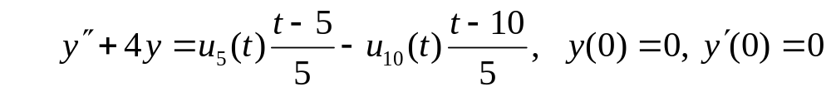
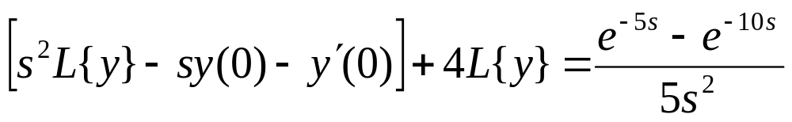
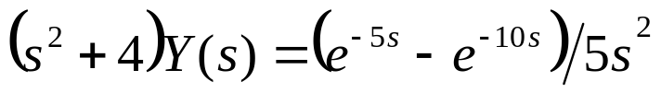
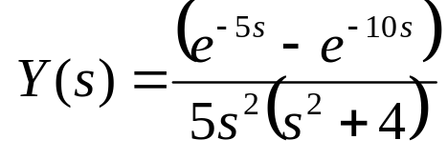
Example 2: Laplace Transform (2 of 12)
Assume that this ODE has a solution y = φ(t) and that φ'(t) and φ''(t) satisfy the conditions of Corollary 6.2.2. Then
or
Letting Y(s) = L{y}, and substituting in initial conditions,
Thus

Slide 18
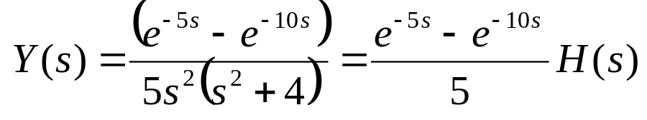
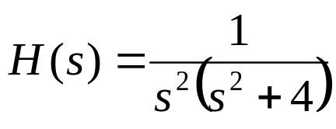
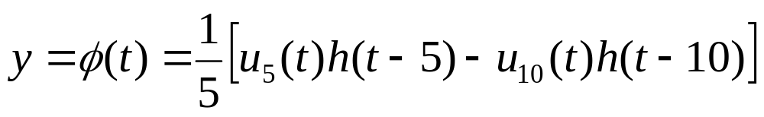
Example 2: Factoring Y(s) (3 of 12)
We have
where
If we let h(t) = L⁻¹{H(s)}, then
by Theorem 6.3.1.

Slide 19
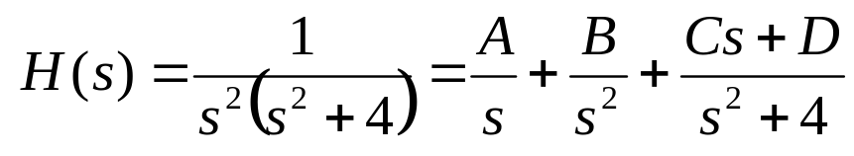
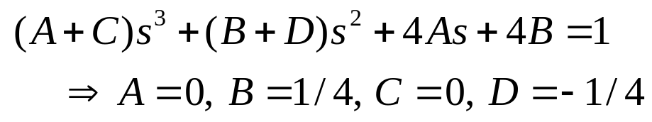
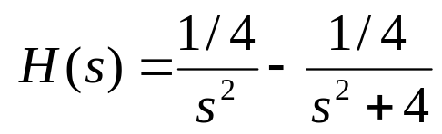
Example 2: Partial Fractions (4 of 12)
Thus we examine H(s), as follows.
This partial fraction expansion yields the equations
Thus

Slide 20
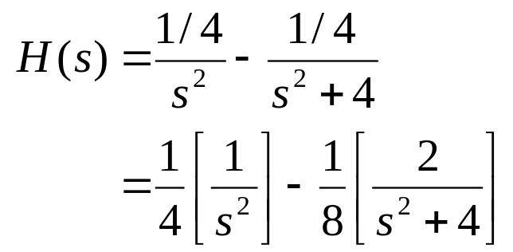
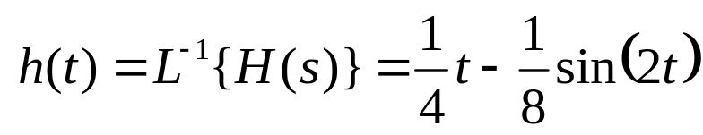
Example 2: Solution (5 of 12)
Thus
and hence
For h(t) as given above, and recalling our previous results, the solution to the initial value problem is then

Slide 21
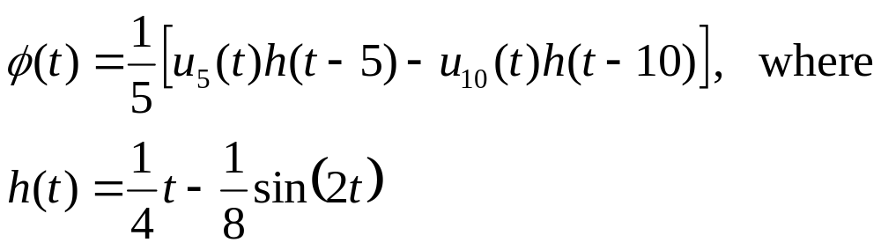
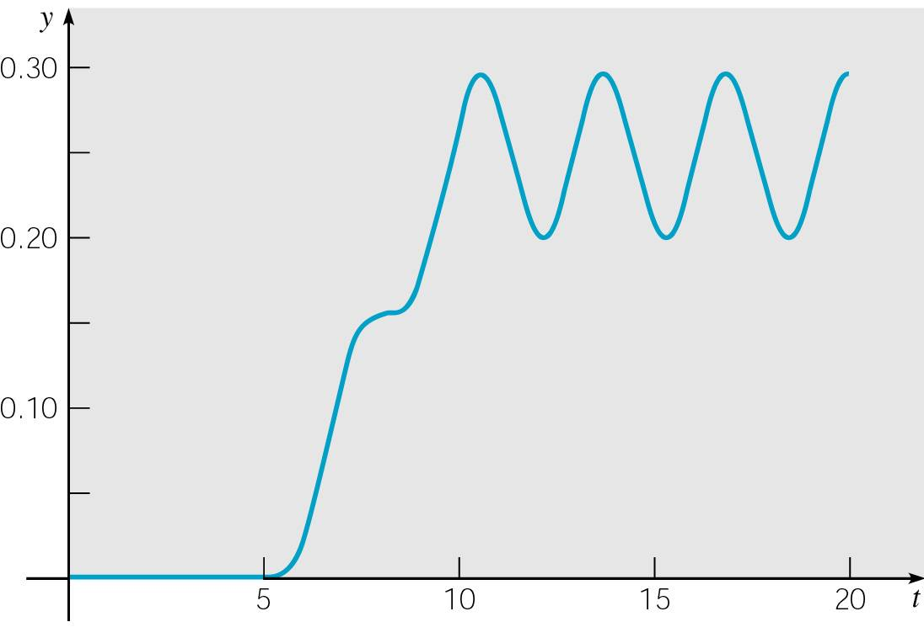
Example 2: Graph of Solution (6 of 12)
Thus the solution to the initial value problem is
The graph of this solution is given below.

Slide 22
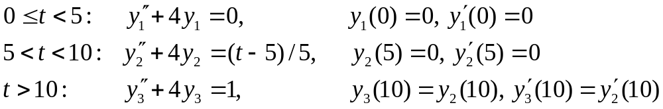
Example 2: Composite IVPs (7 of 12)
The solution to original IVP can be viewed as a composite of three separate solutions to three separate IVPs (discuss):

Slide 23
Example 2: First IVP (8 of 12)
Consider the first initial value problem
From a physical point of view, the system is initially at rest, and since there is no external forcing, it remains at rest.
Thus the solution over [0, 5) is y₁ = 0, and this can be verified analytically as well. See graphs below.

Slide 24
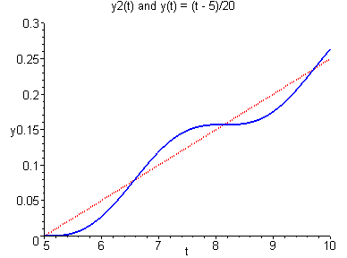
Example 2: Second IVP (9 of 12)
Consider the second initial value problem
Using methods of Chapter 3, the solution has the form
Thus the solution is an oscillation about the line (t – 5)/20, over the time interval (5, 10). See graphs below.

Slide 25

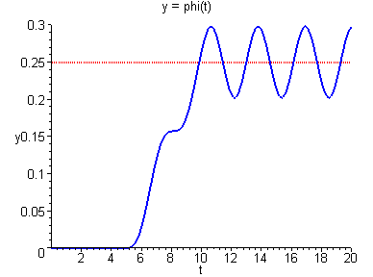
Example 2: Third IVP (10 of 12)
Consider the third initial value problem
Using methods of Chapter 3, the solution has the form
Thus the solution is an oscillation about y = 1/4, for t > 10. See graphs below.

Slide 26
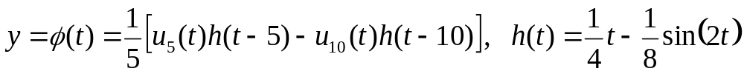
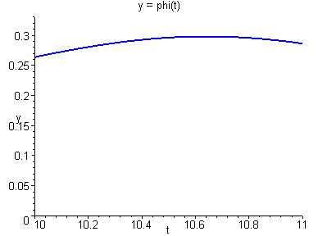
Example 2: Amplitude (11 of 12)
Recall that the solution to the initial value problem is
To find the amplitude of the eventual steady oscillation, we locate one of the maximum or minimum points for t > 10.
Solving y' = 0, the first maximum is (10.642, 0.2979).
Thus the amplitude of the oscillation is about 0.0479.

Slide 27
Example 2: Solution Smoothness (12 of 12)
Our solution is
In this example, the forcing function g is continuous but g' is discontinuous at t = 5 and t = 10.
It follows that φ and its first two derivatives are continuous everywhere, but φ''' has discontinuities at t = 5 and t = 10 that match the discontinuities of g' at t = 5 and t = 10.

